Slide 1
Schools Resource
Jazz Carnival: A History

Slide 2
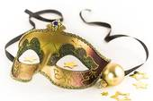
What is Carnival?
In pre-Christian times, there were holidays which resemble modern day Carnivals.
In Ancient Greece, a large religious festival which included dancing, singing and a masked procession was held in honour of Dionysus, God of wine and agriculture.
In Ancient Rome, a 2 week festival was held in honour of Saturn, God of grain, vegetation and wine. Class boundaries were removed via the use of face masks, so everyone was of equal status for the duration of the festival.
These pre-Christian celebrations are thought to have been adapted by the Roman Catholic Church for the period preceding Ash Wednesday, the beginning of Lent. Before the 40 sombre days of Lent, when Roman Catholics abstained from eating meat, a party was definitely in order, if only to use up their “luxury” goods prior to Lent. Hence the meaning of the word “Carnival”; it comes from the Italian word of Carne (meat) and Levare (remove).
In many parts of the world where Catholic Europeans set up colonies and entered into the Slave trade, Carnival took root.

Slide 3
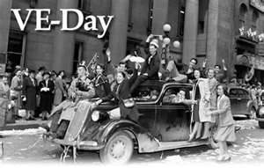
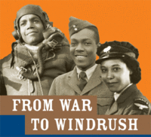
Carnival: from Africa to the Caribbean and to the UK
After the Second World War, the UK Government encouraged mass immigration from the British Empire to help rebuild the country.
The Immigrants brought with them their customs and traditions, including Carnival traditions.
Countries with strong Catholic traditions, such as Trinidad and Tobago, also had the strongest Carnival traditions.
Today, some of the largest influences on Carnival in the UK originate from African, Caribbean, Indian and Irish communities. These include the African tradition of parading and moving in circles through villages in costumes and masks, thought to bring good fortune and appease ancestors.

Slide 4
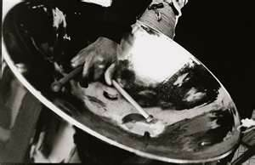
Carnival Music
Africans who were brought to the Caribbean as Slaves used ‘talking drums’ to communicate. In the late 1880s, drumming was outlawed out of fear it would spark a rebellion.
Forbidden to talk to each other, the Slaves on the sugar plantations began to sing songs. They used Calypso which can be traced back to West African Kaiso, to communicate and to mock their “Masters”.
In 1936, the Steel Pan was invented when it was discovered that different tones could be created using oil drums.
The Samba developed through blending of cultures as a result of the Portuguese colonisation of Brazil, a country which is famous for its strong Carnival tradition.
The arrival of Caribbean Immigrants in the 1940s and 1950s brought new musical influences to the UK, including Calypso, the Soca (a fusion of Soul and Calypso) and Jazz.

Slide 5
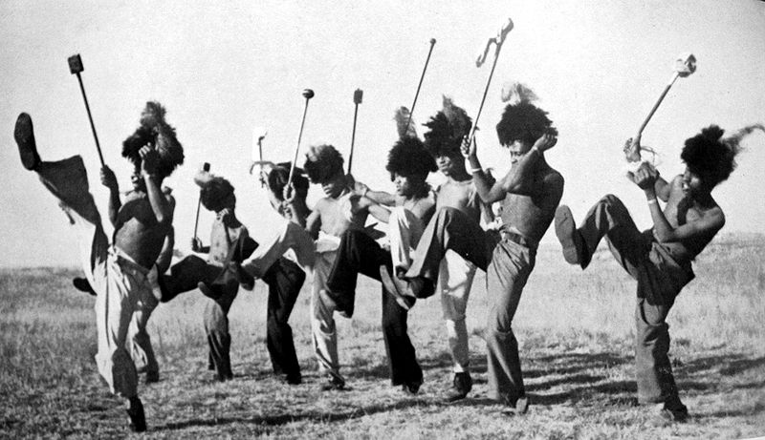
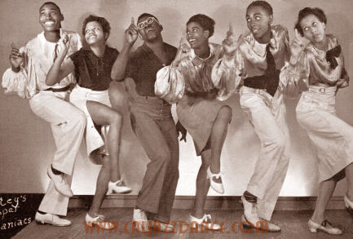
Origins of Jazz Dance
Jazz is an amalgamation of European and tribal African music.
Brought together by black Americans in the early 20th century, in the last days of slavery and the ‘New World’ when Black people settled in New Orleans from various Caribbean Islands, African states and French Colonies.
Originally a mix of Gospel, Blues and Plantation songs combined with African Drum beats.
Roots of dancing to Jazz, therefore, lie in African Tribal Dance: Stomping feet and slapping your body with your hands.
When Jazz began to spread, it was still known as New Orleans Jazz. Although people danced to it in dance halls, it was mainly used for ‘social dancing’. Specialist Dance styles such as Charleston made their appearance, starting off at affluent Society parties.
Jazz also spread to California and then Chicago, which became the hot bed for the Dixie sound. Sadly, it had a reputation for its criminal gangs and lack of restrictions but this was short lived: new laws in 1928 changed all that, sweeping the dance halls away and prohibiting the playing of Jazz Music.

Slide 6
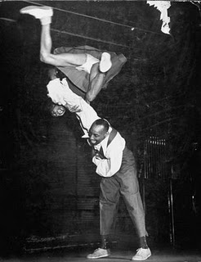
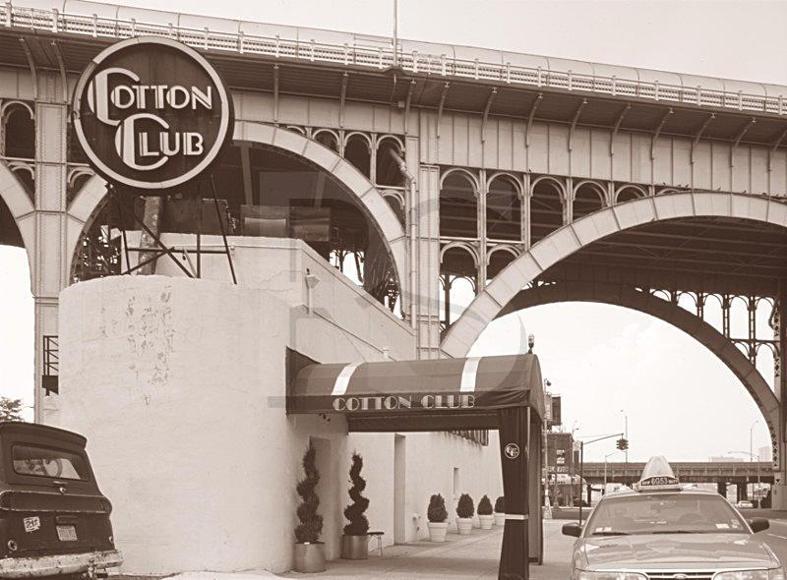
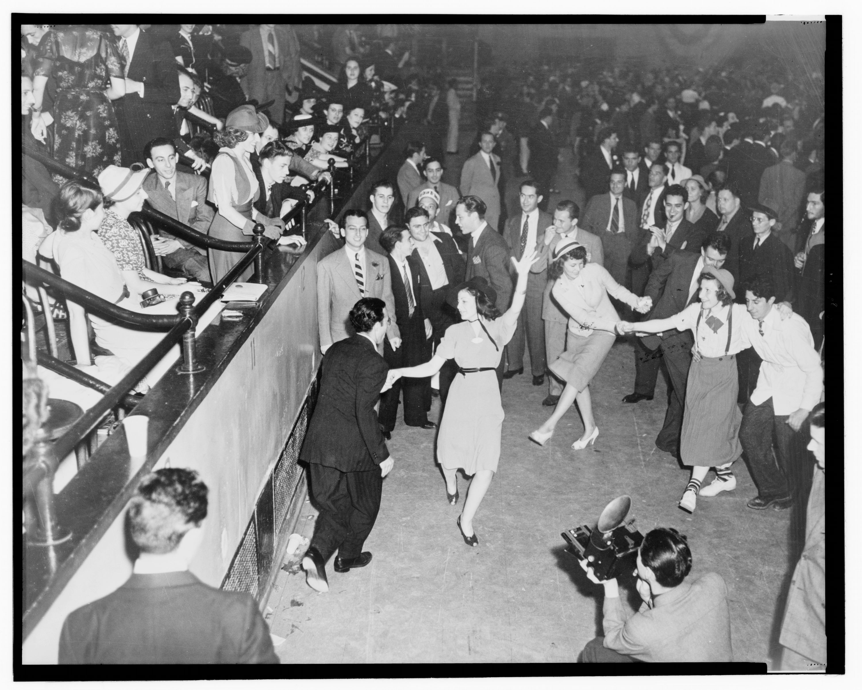
The Big Apple!
Due to the Jazz ban in Chicago, Musicians moved to the hot pot big Apple of New York! There, they played in places such as The Cotton Club, the biggest club in Harlem, where Tap and Chorus Line dancing were featured, too.
The term ‘Swing’ was coined in the 1930’s when ‘Big Bands’ dominated the Music scene whose sound appealed to the Youth culture of the time, who had the disposable income to attend large dance hall events where couples would do the Jive.
Black Musicians were allowed to play in Dance Halls but they had to go through the back door. At the end of those gigs many Musicians would go to the hip joints and hot houses, jamming all night!
The Music would be much harder, faster and a lot madder! This sparked off dance styles such as The Jitterbug (also known as Lindy Hop). In addition, individual Dancers were huge here, tapping out rhythms and being an important part of the night.

Slide 7
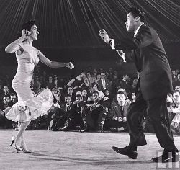
From Be-Bop to Mambo
After World War 2, younger players felt that Swing had been exhausted. These youngsters developed a new sound of Jazz known as Be-Bop; fresh, complex and a lot ‘harder edged’ than Swing.
At the same time, as Musicians toured the world, they were exposed to new cultures and rhythms from across the world. Brazil provided some hot, new rhythms which lent themselves to be fused with Jazz, giving birth to the Bossa Nova.
With Latin Americans coming to America, Porto Ricans, Venezuelans and Cubans created their own rhythms. The fusion of Swing and Cuban music produced a new sensational dance: The Mambo!

Slide 8
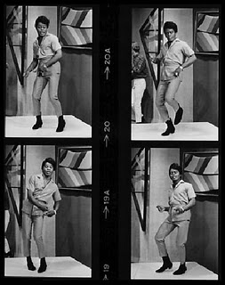
When Jazz met Soul … We got the Funk!
While some of the world was Jazz mad, Philadelphia and Detroit found their Soul and what happened when Jazz met Soul? We got the Funk
Complex, interlocking, syncopated rhythms characterised by a slapping bass and hard edged guitar riffs.
Legends such as James Brown and Otis Redding were hugely successful Superstars leading bands made up of Musicians who – like them – had grown up around the legacy of the Jazz Age.
Backing Singers of these Artists would create simple Dance sequences which would be copied by the Audience.

Slide 9
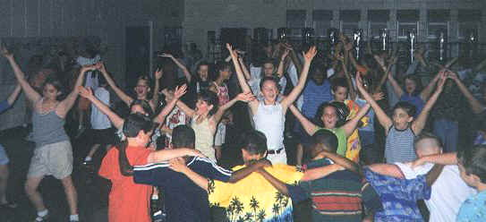
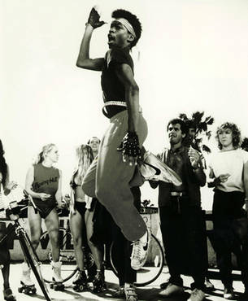
D.i.s.c.o. Break & Street ….the original Version!
As Soul evolved into Disco, Dance had a huge surge in popularity, with competitions being the order of any self respecting club.
In these Disco clubs, trained Dancers from Chorus Lines of theatrical productions would mix with Kids who were into Music and who created their own moves.
Those Kids were known as Street Dancers, as they were not trained yet highly talented, developing their Dance skills in their bedrooms, friends’ houses and on street corners.
Electro Music reared its head around 1982/83 from America. Locking & Popping and the Electric Boogaloo appeared. Then, as the Music moved to Hip Hop, Break Dance was the order of the day, re-using floor moves that originated in the 1930s.
Since then, things have come full circle. Modern day House, Garage and Drum & Bass Dancers use simplified versions of original Jazz, Soul and Funk Dance Footwork. Today’s Street Dance uses the Locking & Popping elements of the 1980s and is mixed with the acrobatic/gymnastic tricks originally used in the 1930s and re-created for 1980’s Break Dance.

Slide 10
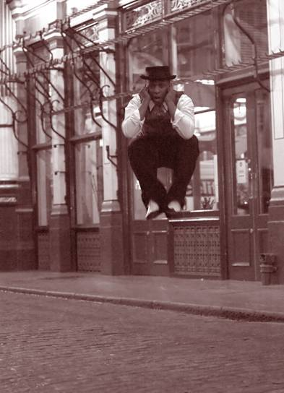
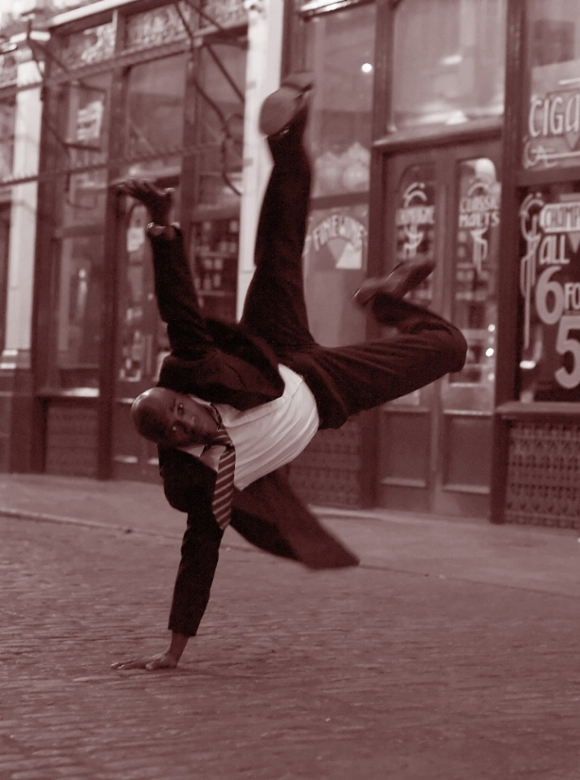
UK Street-Fusion Jazz Dance
Whilst Disco was huge, there were clubs in the UK where DJs dropped a sound imported mainly from America.
Fusing Soul, Funk, Disco and Jazz, crossing again and again, breaking boundaries across the musical world, it became known as Jazz Fusion, an explosion of Jazz and Folk, Pop, Funk, Rock and Latin, Afro-Cuban and Brazilian rhythms.
To this music, mainly played in underground clubs, Dancers created their own Dance style
Born was Street-Fusion-Jazz-Dance, a uniquely British style which challenges Dancers’ ability to change with the new rhythms and "follow" the music.

Slide 11
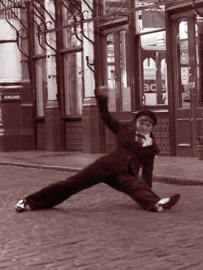
UK Street-Fusion Jazz Dance
A breathtaking mix of fast, syncopated rhythms, intricate footwork (also known as Shuffles), spins, so-called drop moves and also floor work and knee spins. An attack on all senses!
Using the music's varying rhythm patterns, the style works on Dancers' creativity, their understanding of the music and their own energy.
Totally different from what is mostly associated with Jazz Dance – no Jazz Hands and definitely not the Cabaret style taught in Dance Schools around the world.

Slide 12
Street Jazz at the Carnival
Throughout its history, Carnival has meant a period of celebration and happiness, and as a way for people to reclaim the streets. So at its core, Carnival is a communal expression of the hope and desire for social freedom.
The UK’s largest Carnival is in Notting Hill, West London, which started in 1964, as a way to ease racial and social tensions in the area by encouraging people, both black and white, to go into the streets and express themselves socially as well as artistically.
1976 saw the first Luton Carnival as we know it. This began as a Victorian Fayre with a procession and was held to celebrate the 100th anniversary of Luton becoming a Borough. Over the years the fair element has declined and now the focus is on the carnival procession. In 1998, Luton Carnival acquired International status.
The essence of Carnival is embodied by the five Artistic Arenas - Calypso, Mas (masquerade), Pan (steel bands) and the Mobile and Static Sound Systems.
Carnival includes a whole street-style symphony of sound. Its genre is known as “world music,” which has a simple definition: international music with tribal origins.

Slide 13
Street Jazz at the Carnival
Through the use of Sound Systems, Jazz has always played a huge part in Carnival, being at the root of many popular music styles.
The sound system concept first became popular in the 1950's, in Kingston, Jamaica. In an environment where black, artistic and social expression was discouraged, Sound systems were created for the dispossessed. DJs would load up a truck with a generator, turntables, and huge speakers and set up street parties.
The success of sound systems have been partly based on their mobile nature and the ability to foster a feeling of “community”, not only through the music that was being played, but also through the income opportunities that the events offered for the whole community.
In the UK, Sound Systems have always been at the heart of Carnival and have proven crucial to the development of UK urban music; from Jazz to Funk to Soul to Hip Hop.

